Slide 1






C# Auto Mapping Objects
Manual Mapping
and AutoMapper Library
DTOs
SoftUni Team
Technical Trainers
Software University
http://softuni.bg

Slide 2

Table of Contents
DTO Definition
Manual Mapping
AutoMapper

Slide 3
Questions
sli.do #CSharpDB

Slide 4
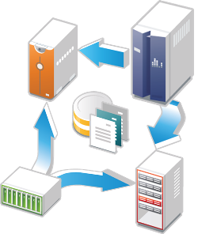
Data Transfer Objects
Definition and Usage

Slide 5
What is a Data Transfer Object?
A DTO is an object that carries data between processes
Used to aggregate only the needed information in a single call
Example: In web applications, between the server and client
Doesn't contain any logic – only stores values
public class ProductDTO
{
public string Name { get; set; }
public int StockQty { get; set; }
}

Slide 6
DTO Usage Scenarios
Remove circular references
Hide particular properties that clients are not supposed to view
Omit some properties in order to reduce payload size
Flatten object graphs that contain nested objects, to make them more convenient for clients
Decouple your service layer from your database layer

Slide 7
Manual Mapping
Relationship Diagram
Product
Storage
ProductId
Name
Description
StorageId
Name
Location
ProductStock
Additional data
in mapping table
Quantity
ProductId
StorageId

Slide 8
Manual Mapping (2)
Get product name and stock quantity in a new DTO object
var product = context.Products.FirstOrDefault();
var productDto = new ProductDTO
{
Name = product.Name,
StockQty = product.ProductStocks
.Sum(ps => ps.Quantity)
};
Aggregate information from mapping table

Slide 9

AutoMapper Library
Automatic Translation of Domain Objects

Slide 10
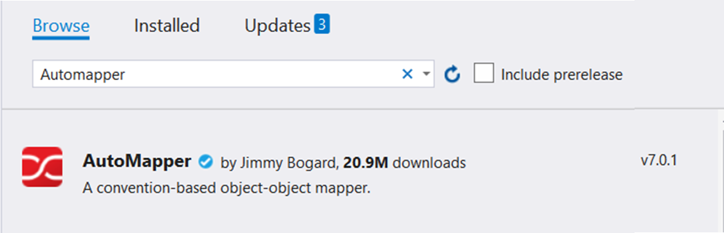
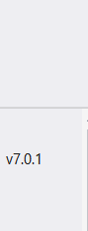
What is AutoMapper?
Library to eliminate manual mapping code
Available as a NuGet Package
Official GitHub Page
Install-Package AutoMapper

Slide 11
Initialization and Configuration
AutoMapper offers a static service for use and configuration
Add mappings between objects and DTOs
Properties will be mapped by name
Source
Target
Mapper.Initialize(cfg => cfg.CreateMap<Product, ProductDTO>());
var product = context.Products.FirstOrDefault();
ProductDTO dto = Mapper.Map<ProductDTO>(product);

Slide 12
Multiple Mappings
You can configure all mapping configurations at once
Mapper.Initialize(cfg =>
{
cfg.CreateMap<Product, ProductDTO>();
cfg.CreateMap<Order, OrderDTO>();
cfg.CreateMap<Client, ClientDTO>();
cfg.CreateMap<SupportTicket, TicketDTO>();
});

Slide 13
Custom Member Mapping
Map properties that don't match naming convention
Mapper.Initialize(cfg =>
cfg.CreateMap<Product, ProductDTO>()
.ForMember(dto => dto.StockQty,
opt => opt.MapFrom(src =>
src.ProductStocks.Sum(p => p.Quantity))));
Destination property
Source

Slide 14
Flattening Complex Properties
AutoMapper can also be used to flatten complex properties
Mapper.Initialize(cfg =>
cfg.CreateMap<Event, CalendarEventViewModel>()
.ForMember(dest => dest.Date,
opt => opt.MapFrom(src => src.Date.Date))
.ForMember(dest => dest.Hour,
opt => opt.MapFrom(src => src.Date.Hour))
.ForMember(dest => dest.Minute,
opt => opt.MapFrom(src => src.Date.Minute)));

Slide 15
Mapping Collections
EF Core uses IQueryable<T> for all DB operations
AutoMapper can work with IQueryable<T> to map classes
Using AutoMapper to map an entire DB collection:
Works like an automatic .Select()
EF Core generates optimized SQL (like with an anonymous object)
var posts = context.Posts
.Where(p => p.Author.Username == "gosho")
.ProjectTo<PostDto>()
.ToArray();
IQueryable<Post>
IQueryable<PostDto>

Slide 16
Flattening Complex Objects
Flattening of related objects is automatically supported
AutoMapper understands ClientName is the Name of a Client
public class OrderDTO
{
public string ClientName { get; set; }
public decimal Total { get; set; }
}
Mapper.Initialize(cfg => cfg.CreateMap<Order, OrderDTO>());
OrderDTO dto = Mapper.Map<Order, OrderDTO>(order);

Slide 17
Inheritance Mapping
Inheritance chains are defined via Include()
AutoMapper chooses the most appropriate child class
Register with parent
Mapper.Initialize(cfg => {
cfg.CreateMap<Order, OrderDto>()
.Include<OnlineOrder, OnlineOrderDto>()
.Include<MailOrder, MailOrderDto>();
cfg.CreateMap<OnlineOrder, OnlineOrderDto>();
cfg.CreateMap<MailOrder, MailOrderDto>();
});
Order
OnlineOrder
MailOrder
Child mapping

Slide 18
Mapping Profiles
We can extract our configuration to a class (called a profile)
Using our configuration class:
public class ForumProfile : Profile
{
public ForumProfile()
{
CreateMap<Post, PostDto>();
CreateMap<Category, CategoryDto>();
}
}
using AutoMapper;
Mapper.Initialize(cfg => cfg.AddProfile<ForumProfile>());

Slide 19

Summary
To reduce round-trip latency and payload size, data is transformed into a DTO
AutoMapper is a library that automates this process and reduces boilerplate code
Complex objects can be flattened to fractions of their sizes

Slide 20







C# Auto Mapping Objects
https://softuni.bg/courses/databases-basics-ms-sql-server

Slide 21






SoftUni Diamond Partners

Slide 22






SoftUni Diamond Partners

Slide 23
License
This course (slides, examples, demos, videos, homework, etc.) is licensed under the "Creative Commons Attribution-NonCommercial-ShareAlike 4.0 International" license
Attribution: this work may contain portions from
"Databases" course by Telerik Academy under CC-BY-NC-SA license

Slide 24





Trainings @ Software University (SoftUni)
Software University – High-Quality Education, Profession and Job for Software Developers
softuni.bg
Software University Foundation
http://softuni.foundation/
Software University @ Facebook
facebook.com/SoftwareUniversity
Software University Forums
forum.softuni.bg

